Slide 1
Data Transformations in Python

Slide 2
What are Transformations?
Code that changes the shape of your data

Slide 3
Transpose
dataFrame.T
Student | Name | Grade
1 | Terry | A
2 | Tina | B
3 | Tom | A
Student | 1 | 2 | 3
Name | Terry | Tina | Tom
Grade | A | B | A

Slide 4
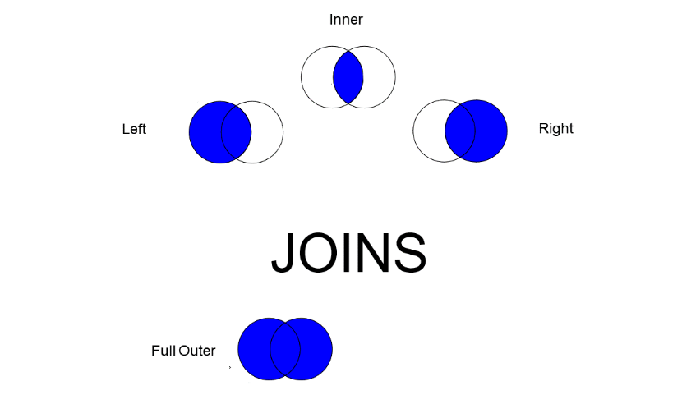
Types of Merges
Like JOIN in SQL

Slide 5
Merge
NewDataFrame = pd.merge(data1, data2, on=ID)
Student | Name | Grade
1 | Terry | A
2 | Tina | B
3 | Tom | A
Student | Name | Grade | Class
1 | Terry | A | Stats
2 | Tina | B | R
3 | Tom | A | Python
Student | Class
1 | Stats
2 | R
3 | Python

Slide 6
Append – Add Columns
You don’t need an id to merge on – just adds them on the left
Be careful! Be certain your data’s in the same order!
pd.concat([data1, data2], axis=1)
Name | Grade
Terry | A
Tina | B
Tom | A
Class
Stats
R
Python
Name | Grade | Class
Terry | A | Stats
Tina | B | R
Tom | A | Python

Slide 7
Append – Add Rows
Must have the same name and number of columns
pd.concat([data1, data2])
Student | Name | Grade
1 | Terry | A
2 | Tina | B
3 | Tom | A
Student | Name | Grade
1 | Terry | A
2 | Tina | B
3 | Tom | A
4 | Gina | A
5 | Reggie | B
6 | Rufus | C
Student | Name | Grade
4 | Gina | A
5 | Reggie | B
6 | Rufus | C

